Slide 1
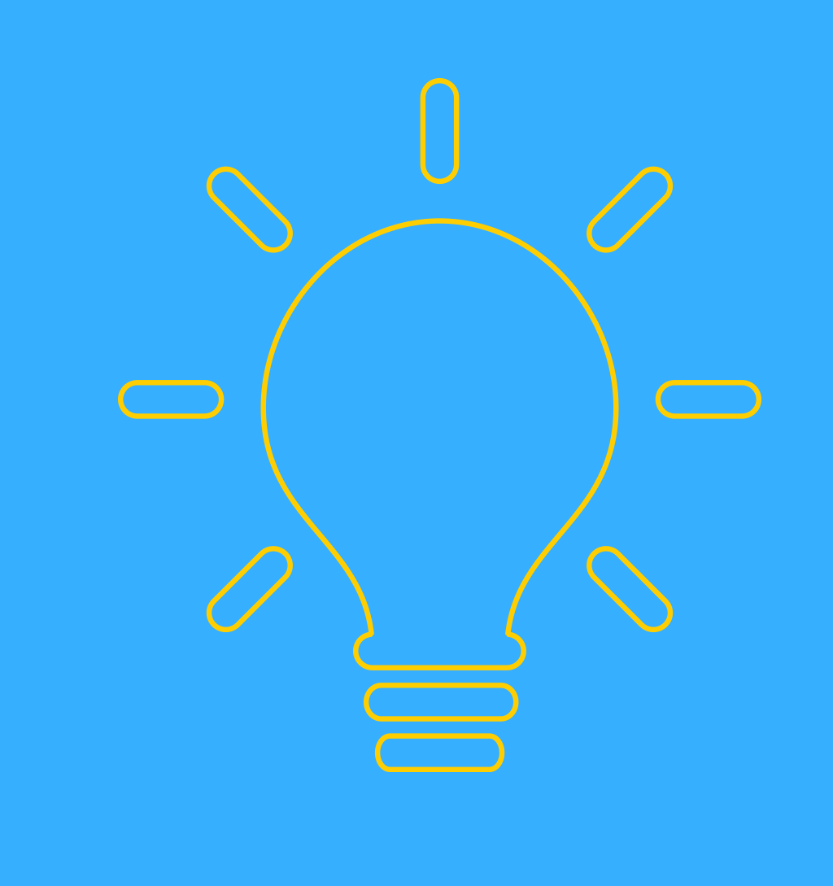
SIMPLE LIFE
江建德、許家維、陳俊甫、楊子權、陳聿懷、呂昶毅、許庭柯

Slide 2
Requirement
The user is able to use their cellphone app to send commands to a main controller through a WiFi connection.
A signal emitter and a signal receiver form a signal connection, which is registered to the main controller with an ID. Signal emitters are installed on the main controller, and signal receivers are installed on electronic appliances.
The main controller contains a decision maker, which may decide to perform operations on the appliances through user predefined schedule.
The cloud server is provided by us, and all the main controllers will download data from this server.

Slide 3
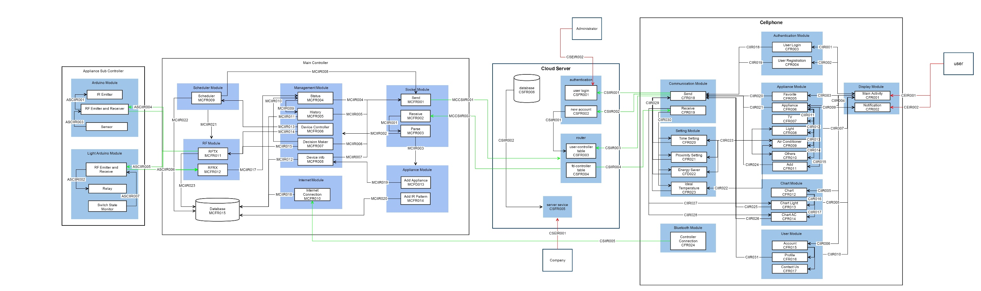
System Architecture

Slide 4
Cellphone Class Diagram

Slide 5
Cellphone code

Slide 6
Cloud Server Class Diagram

Slide 7
Cloud server code

Slide 8
Main Controller Class Diagram

Slide 9
Main controller code

